Slide 1
Chapter 1: Everything is Connected
Vịnh Nguyễn
Introduction to the Internet of Things v2.0
Notes:
Cisco Networking Academy Program
Introduction to the Internet of Things v2.0
Chapter 1: Everything is Connected

Slide 2
Instructor Materials – Chapter 1 Planning Guide
This PowerPoint deck is divided in two parts:
Instructor Planning Guide
Information to help you become familiar with the chapter
Teaching aids
Instructor Class Presentation
Optional slides that you can use in the classroom
Begins on slide # 10
Note: Remove the Planning Guide from this presentation before sharing with anyone.
Notes:
2

Slide 3
Chapter 1: Everything is Connected
Introduction to the Internet of Things v2.0 Planning Guide
Notes:
Cisco Networking Academy Program
Introduction to the Internet of Things
Chapter 1: Everything is Connected

Slide 4
Chapter 1: Activities
What activities are associated with this chapter?
Page # | Activity Type | Activity Name
1.1.1.2 | Lab | How Connected are You?
1.1.1.3 | Activity | Determine Your Digital Generation
1.1.1.4 | Activity | The Impact of Digital Transformation on Business
1.1.1.5 | Activity | Can Smart Devices Think?
1.1.1.6 | Activity | Topic Assessment
1.1.1.7 | Video | Introduction to Packet Tracer
1.1.1.8 | Packet Tracer | Deploying and Cabling Devices
1.1.2.3 | Activity | Network Terms
1.1.2.4 | Lab | Mapping the Internet
1.1.2.5 | Packet Tracer | Creating a Simple Network
1.2.1.2 | Lab | Imagine a New Intelligent Sensor
Notes:
4

Slide 5
Chapter 1: Activities (Cont.)
What activities are associated with this chapter?
Page # | Activity Type | Activity Name
1.2.1.3 | Activity | What are the Benefits of Connecting these IoT Devices?
1.2.1.4 | Lab | Advantages and Disadvantages of IoT Devices
1.2.1.6 | Video | Explore a Smart Home
1.2.1.7 | Activity | Topic Assessment
1.2.2.1 | Packet Tracer | Adding IoT Devices to a Smart Home
1.2.2.2 | Video | Connecting and Monitoring “Things”
1.2.2.3 | Packet Tracer | Connect and Monitor IoT Devices
1.2.2.4 | Videos | 1. IBN 2. Digital Network Architecture
Notes:
5

Slide 6
Chapter 1: Assessment
Students should complete Chapter 1, “Assessment” after completing Chapter 1.
Quizzes, labs, topic assessments and other activities can be used to informally assess student progress.
Notes:
6

Slide 7
Chapter 1: Best Practices
Prior to teaching Chapter 1, the instructor should:
Complete Chapter 1, Quiz
Preview the labs, videos and activities.
Discuss with students the implications of the Digital Transformation. Assign students to research how this is affecting something they are interested in – health, medicine, sports etc.
Use the Imagine a New Intelligent Sensor lab as a group project and have each group present their idea.
Notes:
7

Slide 8
Chapter 1: Additional Help
For additional help with teaching strategies, including lesson plans, analogies for difficult concepts, and discussion topics, visit the Community Forums .
If you have lesson plans or resources that you would like to share, upload them to the Community Forums in order to help other instructors.
Students can enroll in Introduction to Packet Tracer (self-paced)
Notes:
8

Slide 10
Chapter 1: Everything is Connected
Introduction to the Internet of Things v2.0
Notes:
Cisco Networking Academy Program
Introduction to the Internet of Things
Chapter 1: Everything is Connected

Slide 11
Chapter 1 - Sections & Objectives
1.1 Digital Transformation
Explain how digital transformation affects business, industry, and our daily lives.
Explain how digital transformation enables innovation.
Explain how networks provide the platform for Digital Business and society.
1.2 Devices that Connect to the IoT
Configure an IoT device to connect to the network.
Describe the exponential growth of connected IoT devices
Configure devices to communicate in the IoT.
Notes:
11
Cisco Networking Academy Program
Introduction to the Internet of Things
Chapter 1: Everything is Connected

Slide 12
1.1 Digital Transformation
Notes:
1 – Everything is Connected
1.1 – Digital Transformation

Slide 13
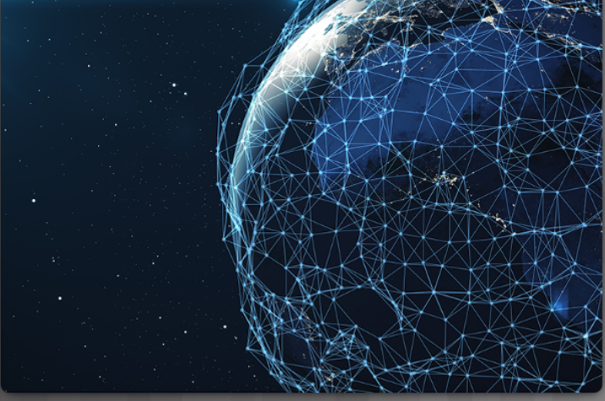
Digitization Transforms Business The Evolution of Digital Transformation
Today there are more smart devices than there are people:
Many people are connected to the Internet 24 hours a day.
By 2020 each consumer will have 6.58 smart devices.
Modern digital networks make all of this possible
Digital transformation is the application of digital technology to provide the stage for business and industry to innovate.
Notes:
1.1 – Digital Transformation
1.1.1 – Digitization Transforms Business
1.1.1.1 – The Evolution of Digital Transformation

Slide 14
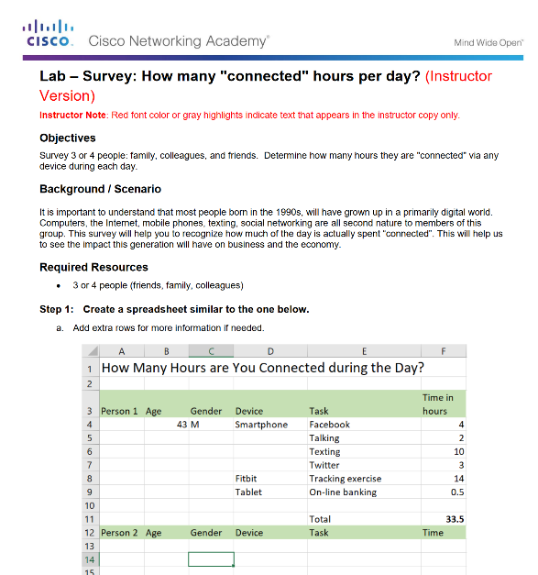
Digitization Transforms Business Lab - How Connected Are You?
Notes:
1.1 – Digital Transformation
1.1.1 – Digitization Transforms Business
1.1.1.2 – Lab - How Connected Are You?

Slide 15
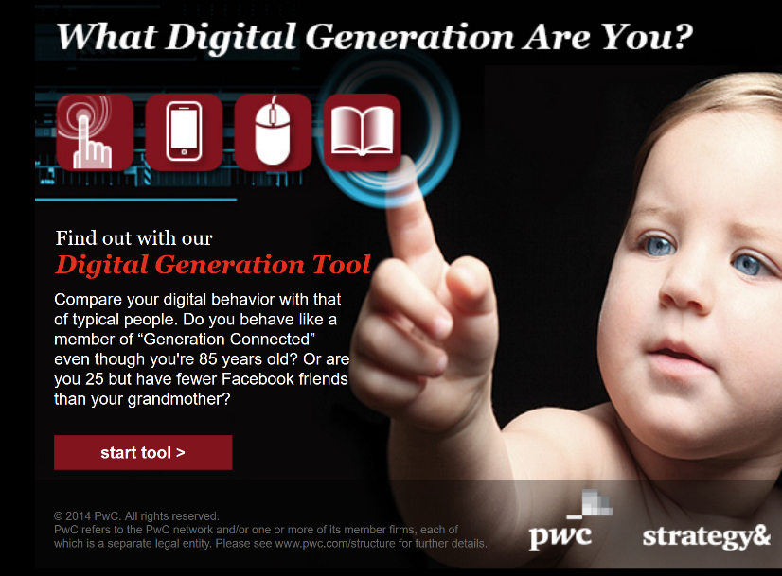
Digitization Transforms Business Lab - Determine Your Digital Generation
Notes:
1.1 – Digital Transformation
1.1.1 – Digitization Transforms Business
1.1.1.3 – Lab - Determine your Digital Generation

Slide 16
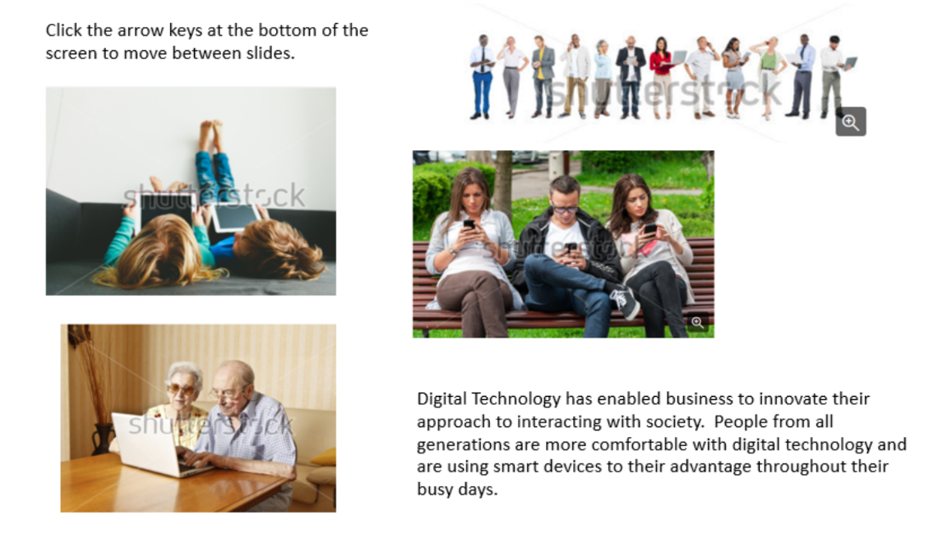
Digitization Transforms Business The Impact of Digital Transformation on Business
Notes:
1.1 – Digital Transformation
1.1.1 – Digitization Transforms Business
1.1.1.4 – The Impact of Digital Transformation on Business

Slide 17
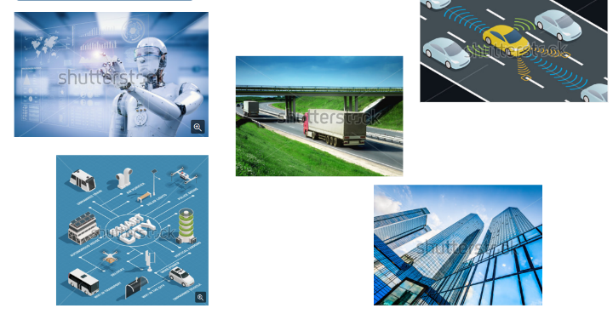
Digitization Transforms Business Can Smart Devices Think?
If programmed appropriately, smart devices are able to evaluate data that is provided to them and modify processes or settings “on the fly”.
If provided with sufficient data, they can “learn” and modify their own code based on the new parameters.
Smart Cities use sensors to control many of their infrastructure systems such as traffic flow, parking, water utilization, and hydro.
Self-driving cars are equipped with many ultrasound sensors, cameras, precision GPSs, and computers.
Notes:
1.1 – Digital Transformation
1.1.1 – Digitization Transforms Business
1.1.1.5 – Can Smart Devices Think?
1.1.1.6 – Topic Assessment

Slide 18
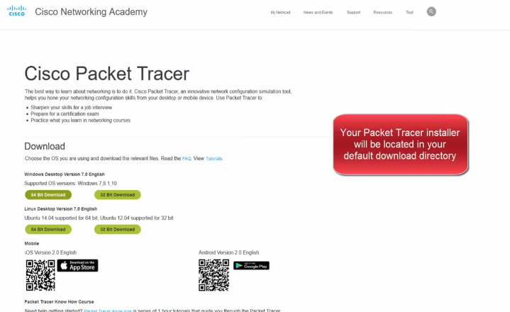
Digitization Transforms Business Video: Download and Install Packet Tracer
Notes:
1.1 – Digital Transformation
1.1.1 – Digitization Transforms Business
1.1.1.7 – Video – Download and Install Packet Tracer

Slide 19
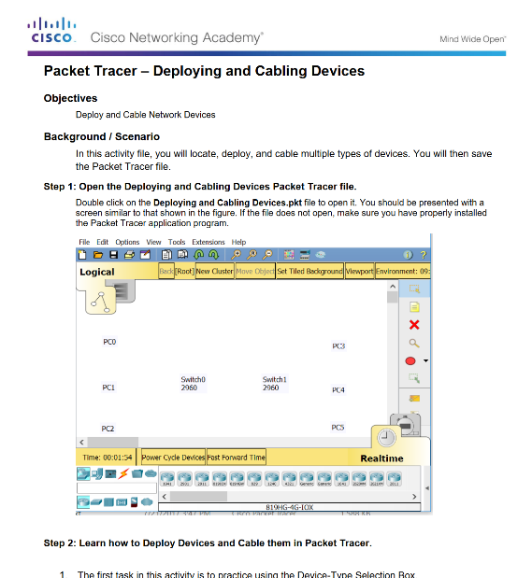
Digitization Transforms Business Lab – Deploying and Cabling Devices
Notes:
1.1 – Digital Transformation
1.1.1 – Digitization Transforms Business
1.1.1.8 – Lab – Deploying and Cabling Devices

Slide 20
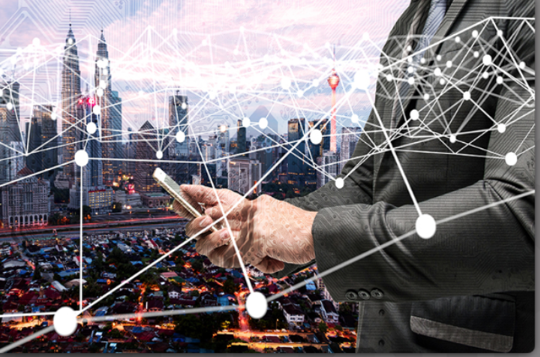
Globally Connected Through Networks Networking is the Foundation
Fifty billion things provide trillions of gigabytes of data
Networks provide the foundation for the Internet and the digitized world.
Networks can range from simple networks consisting of two computers to networks connecting millions of devices.
Networks can provide products and services to customers through their connection to the Internet.
The Internet is the largest network in existence and effectively provides the “electronic skin” that surrounds the planet.
Notes:
1.1 – Digital Transformation
1.1.2 – Globally Connected Through Networks
1.1.2.1 – Networking is the Foundation

Slide 21
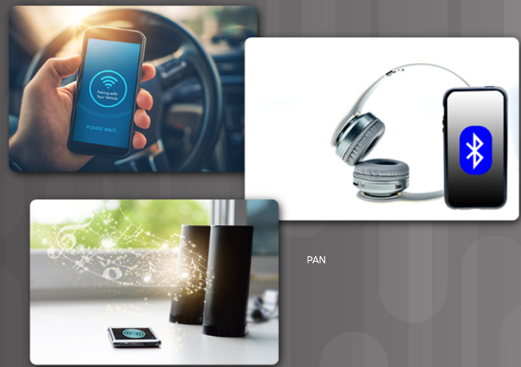
Globally Connected Through Networks Network Types
Local Area Network (LAN) - Networks in a small geographic area, such as a home or small business.
Wide Area Networks (WANs) - A collection of LANs that provides inter-LAN and Internet connectivity.
Internet - A multi-layer global network system that connects hundreds of millions of computers.
Wireless Networks - Use electromagnetic waves to carry signals over the network.
The Cloud - Data centers or groups of connected servers used to store and analyze data, provide access to on-line applications, and provide backup services.
The Edge - The physical “edge” of a corporate network.
Fog Computing - The data from IoT devices can be pre-processed for immediate use in the fog located at the edge of the network.
Personal Area Network (PAN) - Connecting your smartphone to your car using Bluetooth is an example of a PAN.
Notes:
1.1 – Digital Transformation
1.1.2 – Globally Connected Through Networks
1.1.2.2 – Network Types

Slide 22
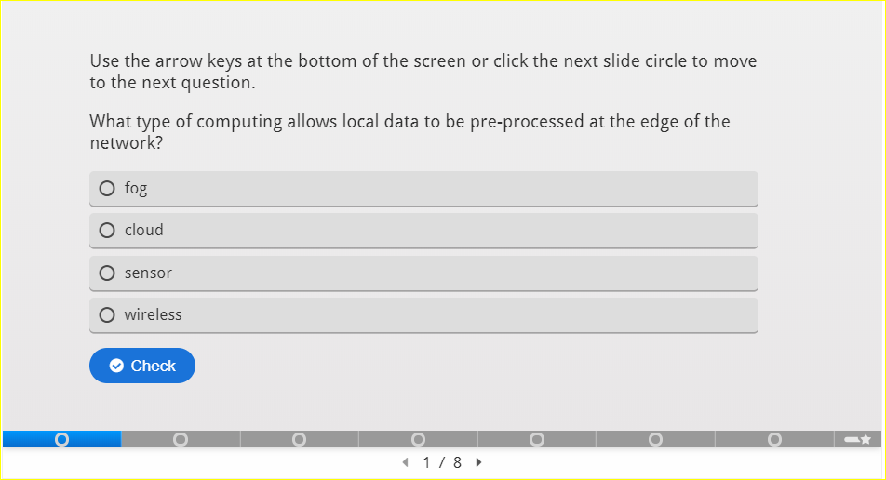
Globally Connected Through Networks Network Terms
Notes:
1.1 – Digital Transformation
1.1.2 – Globally Connected Through Networks
1.1.2.3 – Activity – Network Terms

Slide 23
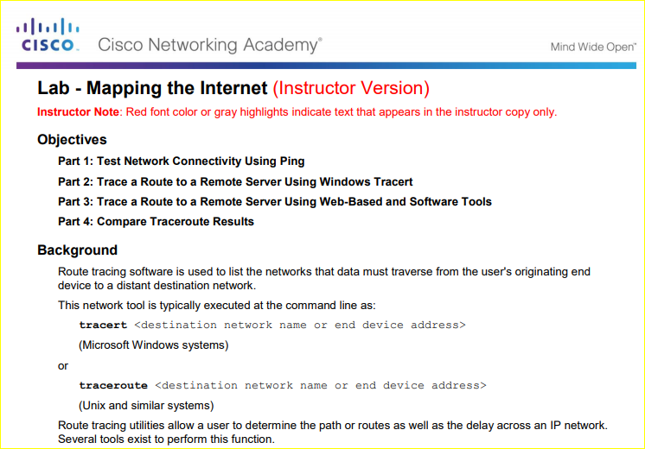
Globally Connected Through Networks Lab – Mapping The Internet
Notes:
1.1 – Digital Transformation
1.1.2 – Globally Connected Through Networks
1.1.2.4 – Lab –Mapping The Internet

Slide 24
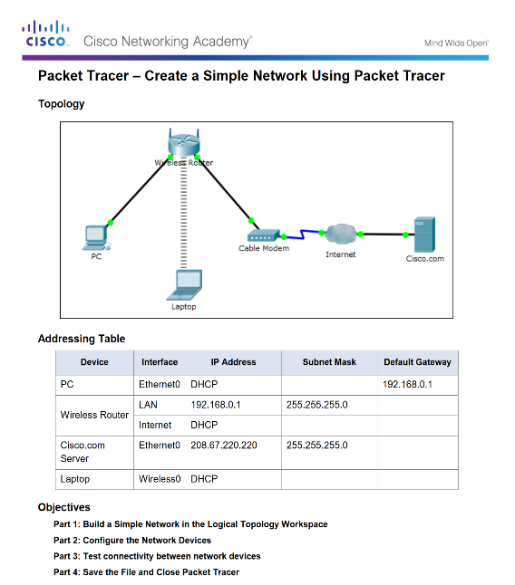
Globally Connected Through Networks Packet Tracer – Create a Simple Network
Notes:
1.1 – Digital Transformation
1.1.2 – Globally Connected Through Networks
1.1.2.5 – Packet Tracer –Create a Simple Network

Slide 25
1.2 Devices that Connect to the IoT
Notes:
1 – Everything is Connected
1.2 – Devices that Connect to the IoT

Slide 26
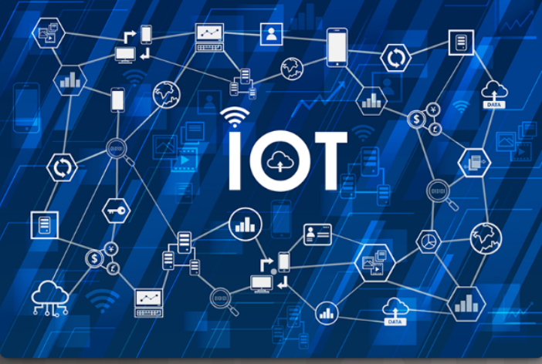
The Growth of IoT Devices What is the IoT?
The Internet of Things (IoT) is the connection of millions of smart devices and sensors connected to the Internet.
Previously inanimate objects such as doorknobs or light bulbs can now be equipped with an intelligent sensor that can collect and transfer data to a network.
An estimated 3 million new devices are connected to the Internet each month.
In the next four years, there are going to be over 50 billion connected devices worldwide.
Two-thirds will be “things”: sensors, actuators, and newly invented intelligent devices that monitor, control, analyze, and optimize our world.
Notes:
1.2 – Devices that Connect to the IoT
1.2.1 – The Growth of IoT Devices
1.2.1.1 – What is the IoT?

Slide 27
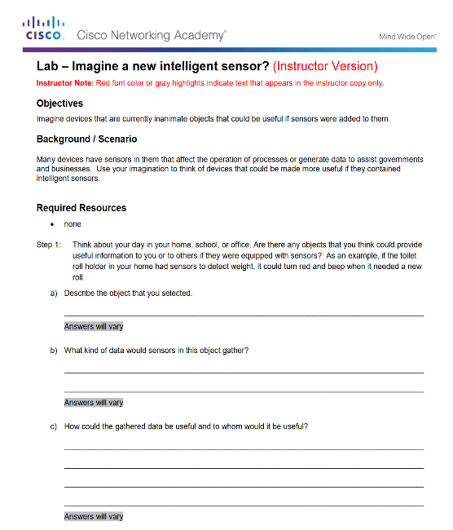
The Growth of IoT Devices Lab – Imagine a New Intelligent Sensor
Notes:
1.2 – Devices that Connect to the IoT
1.2.1 – The Growth of IoT Devices
1.2.1.2 – Lab – Imagine a New Intelligent Sensor
1.1.2.3 – Activity – Network Terms

Slide 28
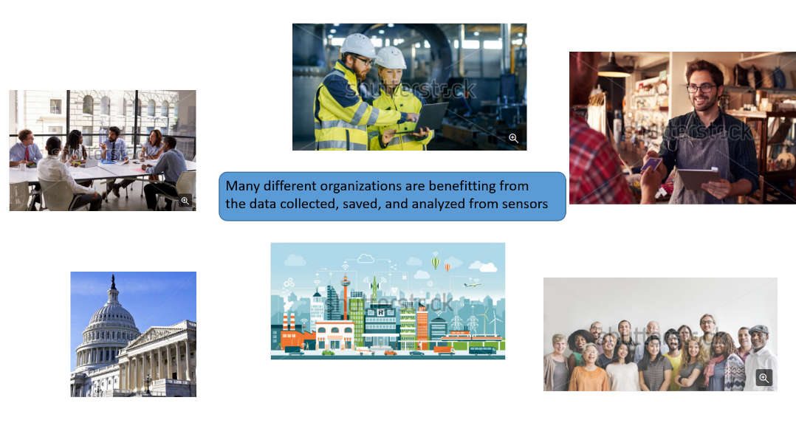
The Growth of IoT Devices What are the Benefits of Connecting these IoT Devices?
Notes:
1.2 – Devices that Connect to the IoT
1.2.1 – The Growth of IoT Devices
1.2.1.3 – What are the Benefits of Connecting these IoT Devices?

Slide 29
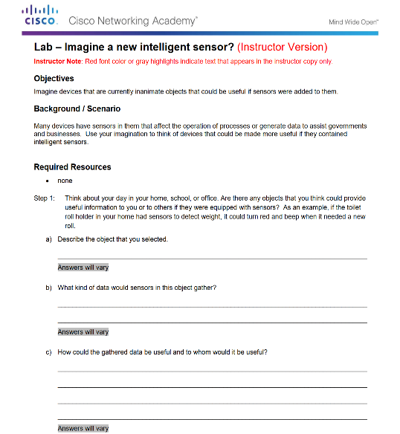
The Growth of IoT Devices Lab - Advantages and Disadvantages of IoT Devices
Notes:
1.2 – Devices that Connect to the IoT
1.2.1 – The Growth of IoT Devices
1.2.1.4 – Lab - Advantages and Disadvantages of IoT Devices

Slide 30
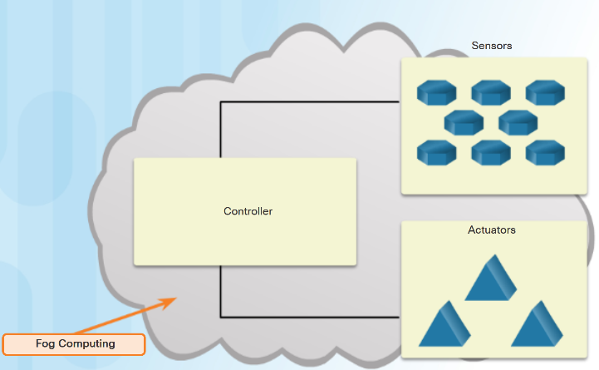
The Growth of IoT Devices How are IoT Devices Connected to the Network?
A sensor needs to be connected to a network so that the gathered data can be stored and shared.
Controllers are responsible for collecting data from sensors and providing network or Internet connectivity.
Controllers may have the ability to make immediate decisions, or they may send data to a more powerful computer for analysis.
Sensors often work together with a device called an actuator.
Actuators take electrical input and transform the input into physical action.
Notes:
1.2 – Devices that Connect to the IoT
1.2.1 – The Growth of IoT Devices
1.2.1.5 – How are IoT Devices Connected to the Network?

Slide 31
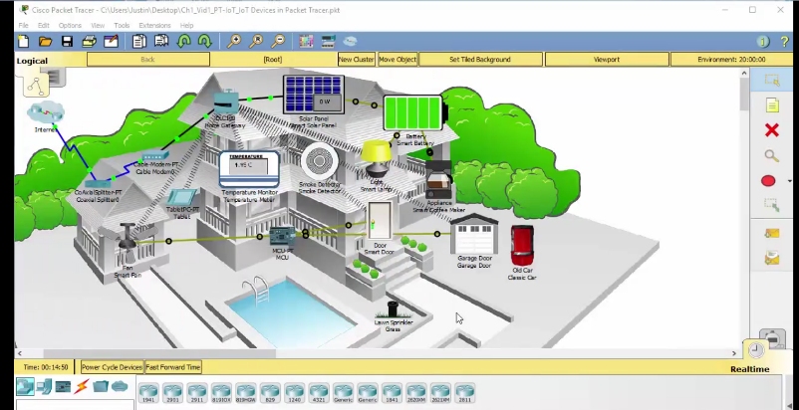
The Growth of IoT Devices Video – Explore a Smart Home
Video demonstrates how to explore a Smart home in Packet Tracer.
Packet Tracer has a wide variety of sensors and smart devices that will allow you to design smart homes, smart cities, smart factories, and smart power grids.
Notes:
1.2 – Devices that Connect to the IoT
1.2.1 – The Growth of IoT Devices
1.2.1.6 – Video – Explore a Smart Home
1.2.1.7 – Topic Assessment

Slide 32
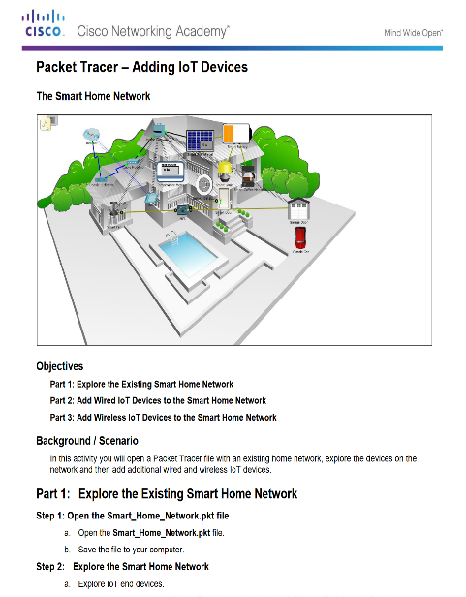
Connecting IoT Devices to the Network Packet Tracer - Add IoT Devices to a Smart Home
Notes:
1.2 – Devices that Connect to the IoT
1.2.2 – Connecting IoT Devices to the Network
1.2.2.1 – Packet Tracer -Connect an IoT Device to the Network

Slide 33
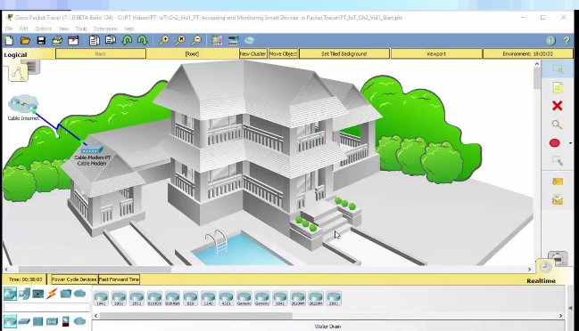
Connecting IoT Devices to the Network Connecting and Monitoring "Things"
The Home Gateway device acts as a local connection to your IoT smart devices:
It is designed to provide Internet access, wireless connectivity, and local logic for smart devices.
It provides an IoT registration service that is always turned on and an auto discovery service for Things in the local Ethernet and wireless network.
The user can control and monitor the smart devices that are connected to the Home Gateway from their smartphone, tablet, or PC.
Notes:
1.2 – Devices that Connect to the IoT
1.2.2 – Connecting IoT Devices to the Network
1.2.2.2 – Connecting and Monitoring "Things"

Slide 34
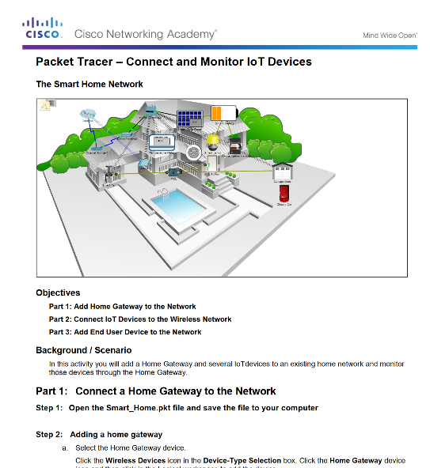
Connecting IoT Devices to the Network Packet Tracer - Connect Devices to a Home Gateway and Monitor
Notes:
1.2 – Devices that Connect to the IoT
1.2.2 – Connecting IoT Devices to the Network
1.2.2.3 – Packet Tracer - Connect Devices to a Home Gateway and Monitor

Slide 35

Connecting IoT Devices to the Network The Future of Networks
Artificial Intelligence (AI) – Devices have the ability to “think” on their own.
Intent-Based Networking (IBN) – Providing software with rules, guidelines, or intent so that data could modify the network, infrastructure features, or security features within a network.
Example - A business defines that a contract employee is given access to only a specific set of data and applications. This is the intent. In an IBN system all the network devices will be automatically configured to fulfil this requirement across the network, no matter where the employee is connected.
Notes:
1.2 – Devices that Connect to the IoT
1.2.2 – Connecting IoT Devices to the NetworkThe Future of Networks
1.2.2.4 – The Future of Networks

Slide 36
1.3 Chapter Summary
Notes:
1 – Everything is Connected
1.3 - Summary

Slide 37
Chapter Summary Summary
As digital networks continue to grow around the world, we are seeing a Digital Transformation - the application of digital technology to provide the stage for business and industry to innovate.
Sensors are now everywhere in the home, on traffic lights, in farm fields, and on our bodies. The analyzed data from sensors is used by governments, cities, businesses, and individuals to effect changes.
Networks form the foundation of the digitized world. Types of Networks:
PAN: Bluetooth
LAN
WAN: Internet, the cloud, fog computing
Wireless: WiFi, Cellular
The Internet of Things is the connection of millions of smart devices and sensors connected to the Internet.
A sensor typically connects to a controller using a wireless connection. Controllers collect data from sensors and send the data for storage or analysis. Controllers may work together with a device called an actuator. Actuators take electrical input and transform the input into physical action.
The future of networking will revolve around artificial intelligence (AI) and intent-based networking (IBN).
Notes:
1 – Everything is Connected
1.3 – Summary

